Slide 1
Helmet Buddy
Breathe Easy, Ride Smart: The Future of Helmet Technology
Presented By: Hamza Kachroo, Didier Lucu, Jarvis Tiu, David Mejia

Slide 2
Table Of Contents
Refresher of Project Main Idea
Current State of Design
Reasons for our design decisions
Current Problems
Future Plans
How we will fix current problems
Upcoming Features
Backup Plans
Workload Partition and Timeline

Slide 3
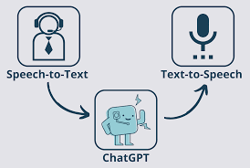
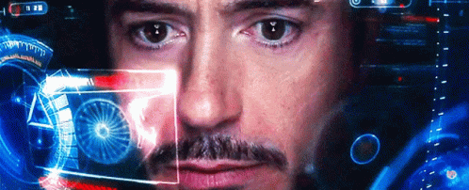
Main Idea
Goals of our Project:
A Smart Helmet with
Speech to Text and Text to Speech functionality
ChatGPT Integration
Object-Detecting Computer Vision
UI display for accelerometer metrics
Voice navigable menu

Slide 4
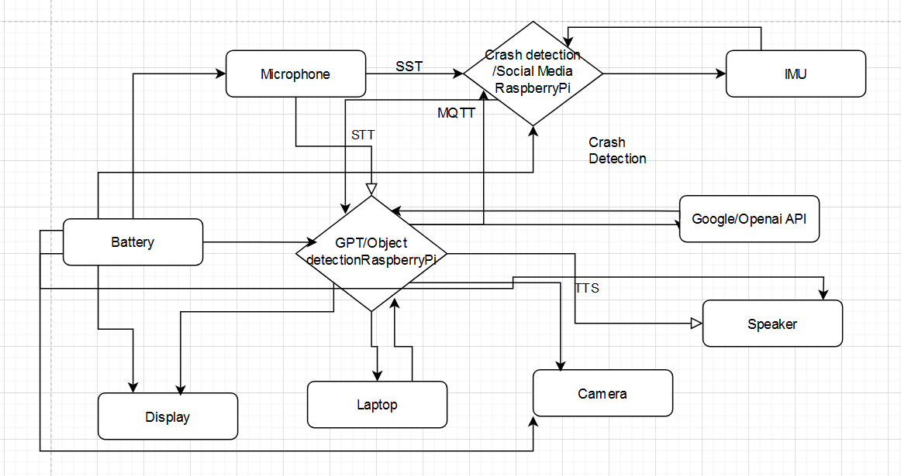
Current Plan of Design - System overview

Slide 5
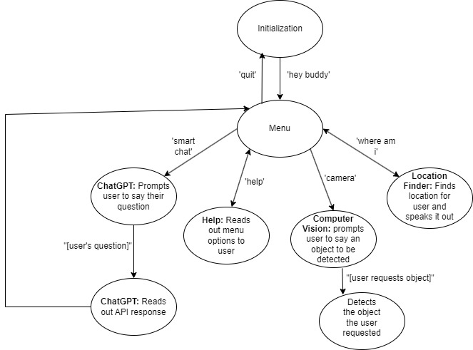
Current State of Design - Voice Navigable Menu

Slide 6
Current State of Design - STT & TTS
For Speech to Text we use Google Speech to Text
Free
No API Key Required
Accurate
Standalone
Center point of other features
Text to Speech: pyttsx3 python library
Easy to integrate with python
Ease of use

Slide 7
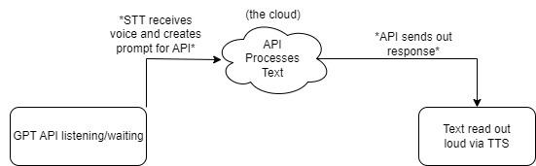
Current State of Design - ChatGPT API integration
GPT version 3.5 Turbo
Reads text from our STT feature
Gathers response from the API service then reads it out

Slide 8
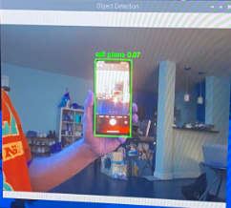
Current State of Design - Object Detection
Technology used
Transformers, torch, TinyYolo
Voice control
Problems and Solutions
Low Processing Power
Limited Object models
Laptop Streaming
Netcat and named Pipe

Slide 9
Current State of Design - Location Finder
Uses geocoders library
Free and easily implementable
Reads out approximate location based on IP address
Only finds a rough estimation of location, not very precise/accurate.

Slide 10
Demonstration Time

Slide 11

Future Plans - Testing and Plans to Remedy Problems
Speech to Text
Experiment with different microphones
Experiment with volume threshold in code
Text to Speech
Experiment with code to select other voices to read out text.
Location Finder
Use a dedicated GPS dongle
Notes:
Stt-check if speed of response is any faster and see how well our voices are being read
Tts-check if other voices are working properly and are coherent
Dongle-portable also more accurte

Slide 12
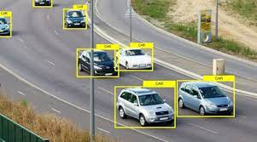
Future Plans - Testing and Plans to Remedy Problems
Computer Vision
Car/Pedestrian Detection
More power
Larger model
Notes:
stronger processing unit
Can detect more objects with larger model
Car pedestrian- have extra camera or pi to allow us to detect objects behind us

Slide 13
Future Plans - Backup Plans
Computer Vision / Object Detection
Difficulties
Remote Connectivity to desktop
Alternative is rear-view camera
Chatbot
Keep same voice
Keep same functionalities
Notes:
One option is to send video to computer and use processor of computer

Slide 14
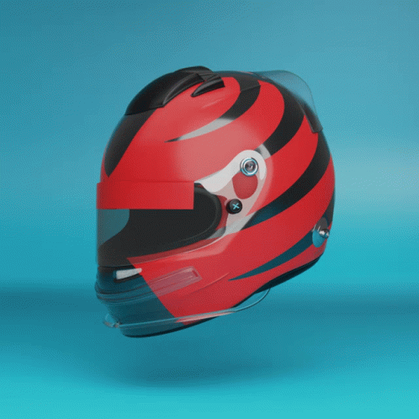
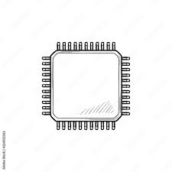
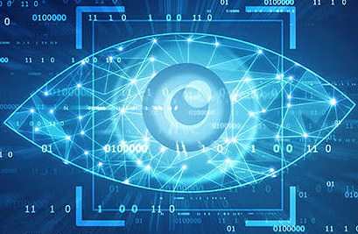
Future Work
Helmet Prototype
Code Optimization
Vision Responsivity
Acquire and repurpose existing model
Modify to accommodate components
Add functionalities
Decrease delay
Create a network using Parallelism
Decrease latency in image detection
Train specific image models

Slide 15



Future Work and Testing
Crash Detection
Transparent Display
Social Media Integration
IMU detects sudden changes in acceleration
Live heads-up display
AR overlay
Bounding boxes for image detection
Use existing STT model create interface to access several social media platforms

Slide 16

Workload Partition and Timeline
David
Didier
Hamza
Jarvis
Display, Social Media Integration, Helmet Acquisition and Prototype
Display, Crash Detection, Streaming
STT/TTS Optimization, Social Media Integration
STT/TTS Optimization, Social Media Integration, Streaming

Slide 17
…Timeline
 | Phase 1 | Phase 2 | Phase 3
Weeks 1-2 | Additional Functionality | Component Integration | Power Supply
Weeks 3-7 | Feature Optimization | Aesthetics | Fully Operational model
Weeks 8-10 | User Trials | Debugging and Optimization | Present Finished Product

Slide 18
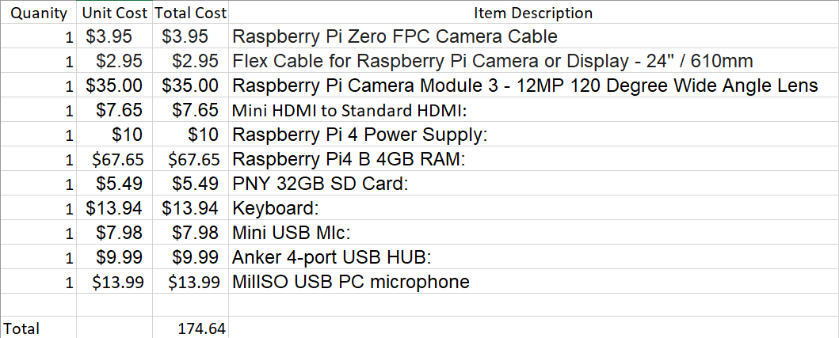
Current Cost Breakdown

Slide 19

Thank You
Summary
1. Speech to Text and Text to Speech: Supports spoken language into text and text synthesization into spoken language and location acquisition
2. ChatGPT Integration: ChatGPT integration allowing users to:
engage in conversations
ask questions
receive text-based responses.
3. Object-Detecting Computer Vision: Detect and identify objects
4. Voice-Navigable Menu: Navigate menus and access various features

Slide 20
BACKUP VIDEO
https://drive.google.com/file/d/1SW_zGVJfN6pH-RGIe7MTwcO_sRDmWDfN/view?usp=sharing

